Slide 1
Welcome to the
Web Application Development with Python L-4
Training Program

Slide 2
Python Dictionary
Lecture
09

Slide 3
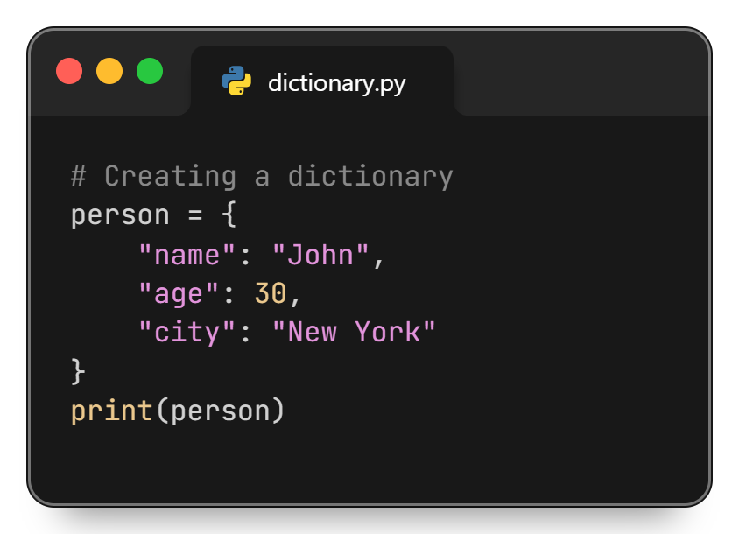
Python Dictionary
A dictionary in Python is a collection of data stored in key–value pairs. Dictionaries are unordered, mutable (changeable), and do not allow duplicate keys. They are widely used to represent real-world data.

Slide 4
Why Use Dictionaries?
Dictionaries are used to:
Store data with meaningful keys
Access values quickly using keys
Represent structured data (e.g., student, product, user)
Map relationships between data

Slide 5
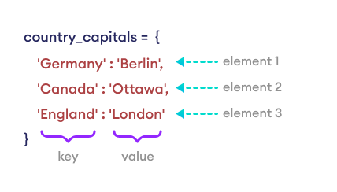
Creating a Dictionary
Dictionaries are created using curly braces { } with key–value pairs separated by a colon(:)

Slide 6
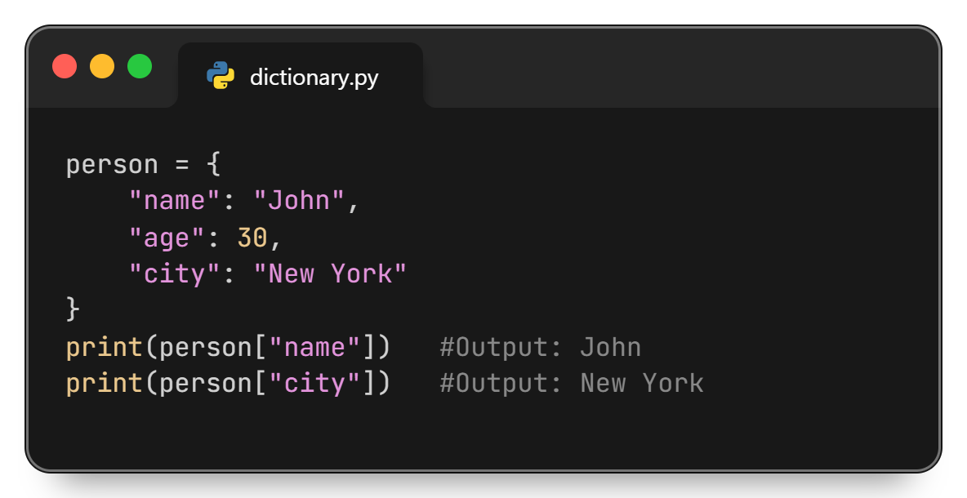
Access Dictionary Elements by Key

Slide 7
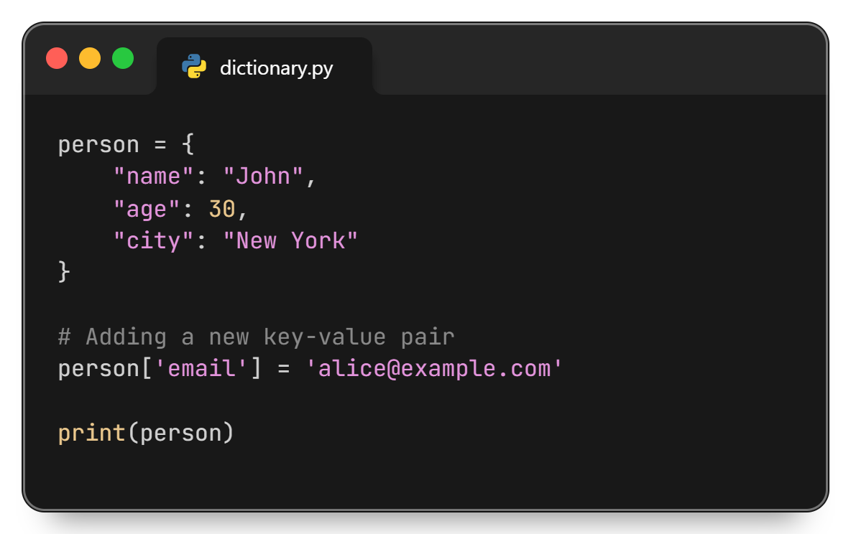
Adding Items

Slide 8
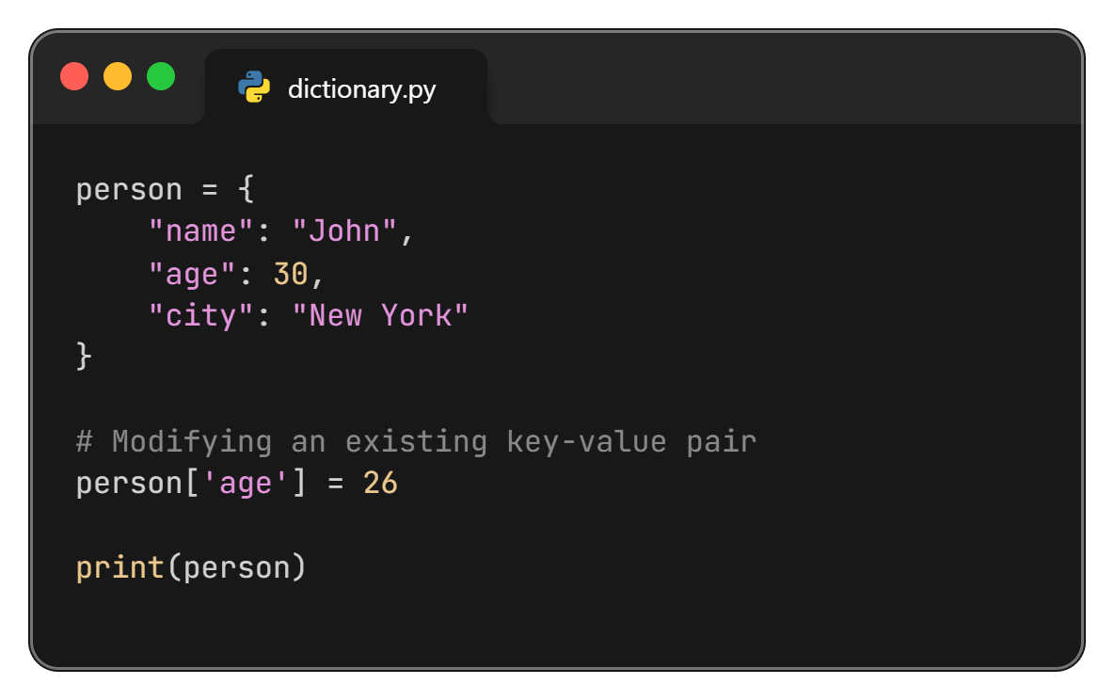
Modifying Items

Slide 9
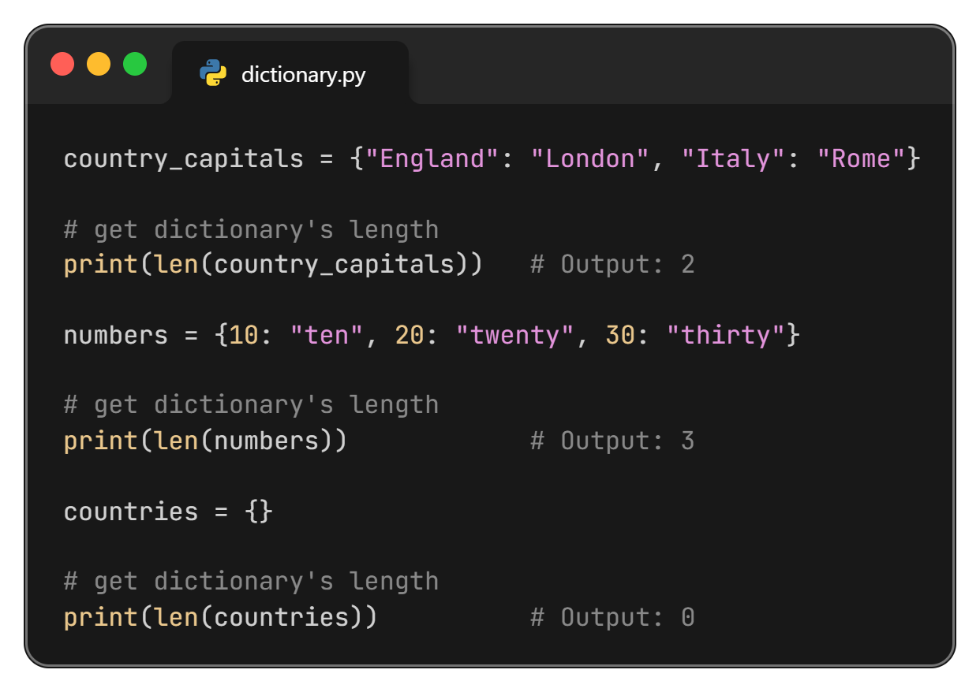
Find Dictionary Length

Slide 10
Removing Dictionary Items

Slide 11
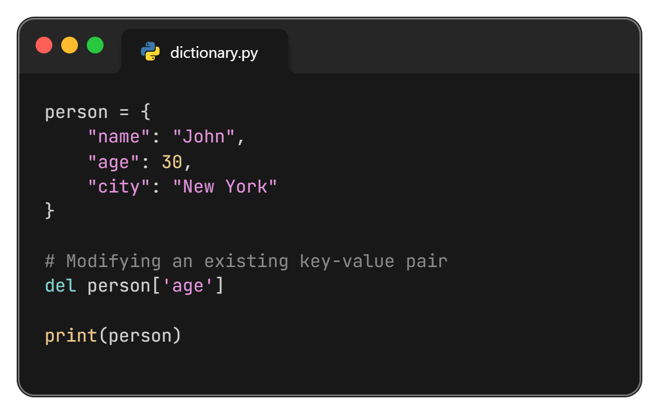
Remove Dictionary Items

Slide 12
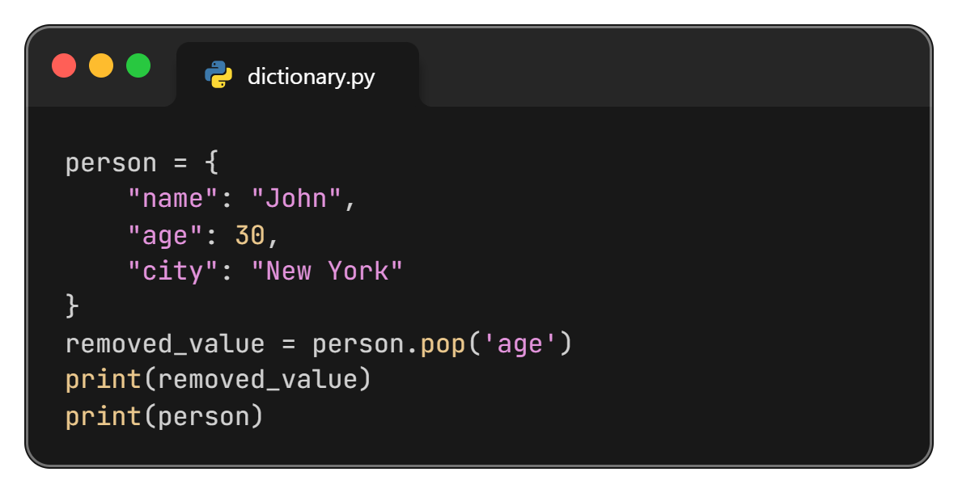
pop() Method in Dictionary
Removes and returns the value associated with the specified key. If the key is not found, it raises a KeyError unless a default value is provided.

Slide 13
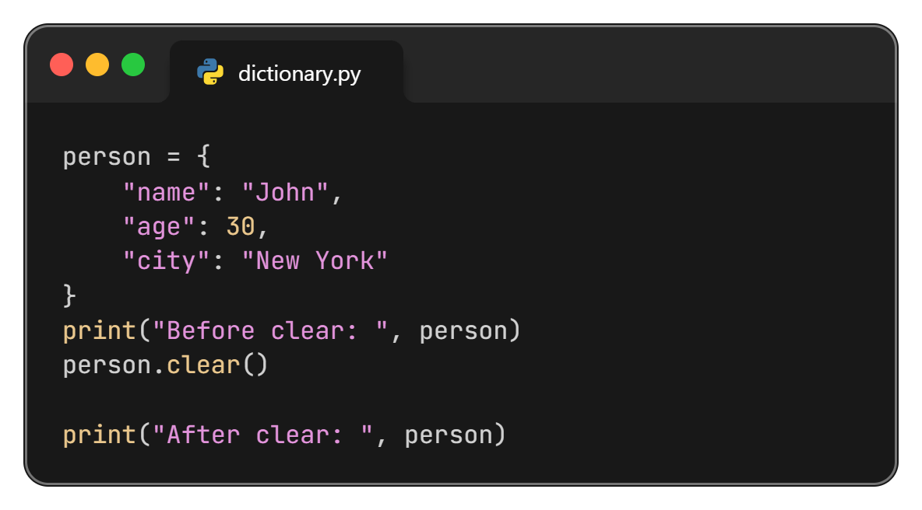
clear() Method in Dictionary
Removes all items from the dictionary.

Slide 14
Method in Dictionary

Slide 15
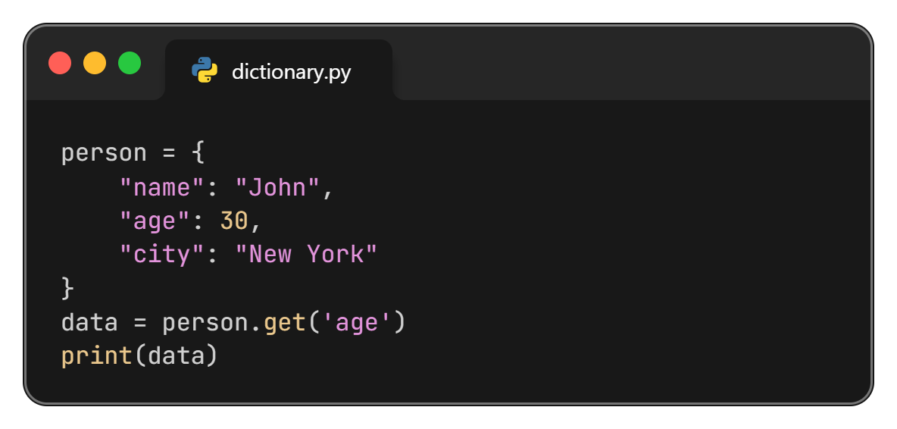
get() Method in Dictionary
Returns the value for a given key. If the key is not found, it returns None.

Slide 16
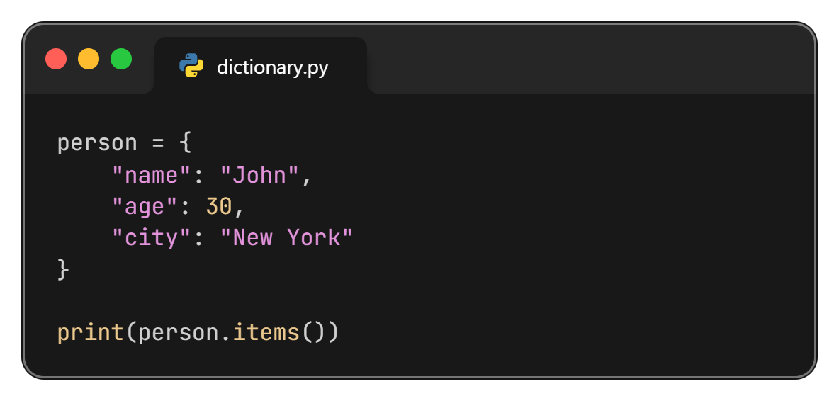
items() Method in Dictionary
Returns a view object that displays a list of dictionary’s key-value tuple pairs.

Slide 17
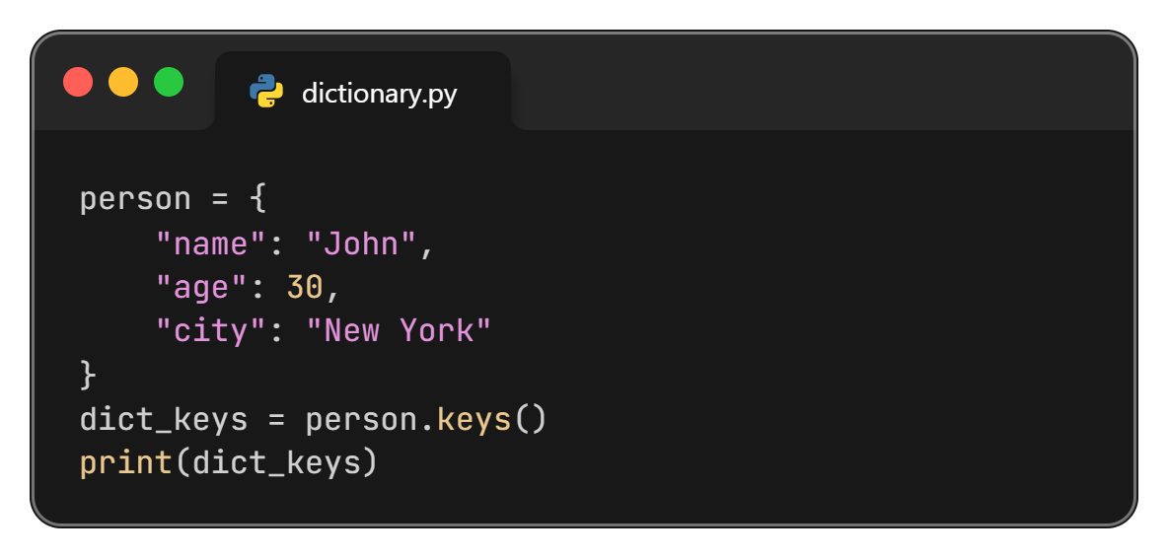
keys() Method in Dictionary
Returns a view object that displays a list of all the keys in the dictionary.

Slide 18
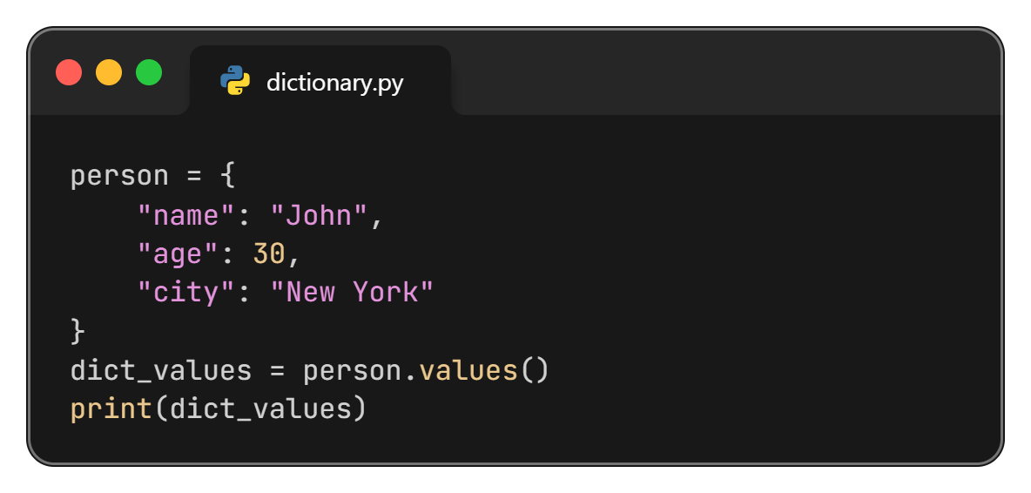
values() Method in Dictionary
Returns the values in the dictionary.

Slide 19
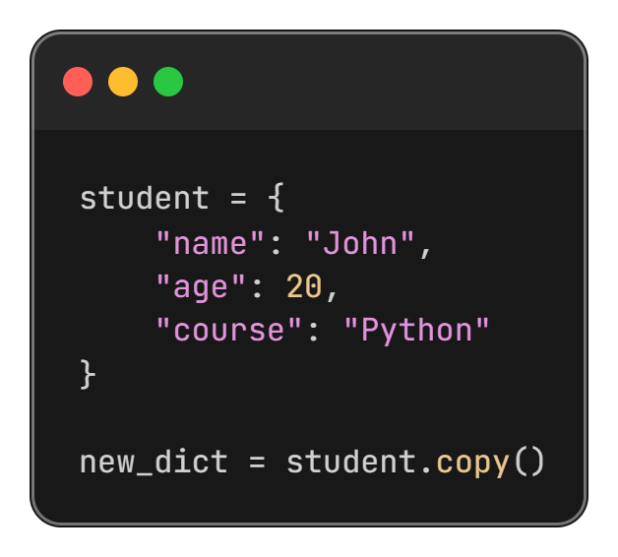
copy() Method in Dictionary
Returns a copy of the specified dictionary.

Slide 20
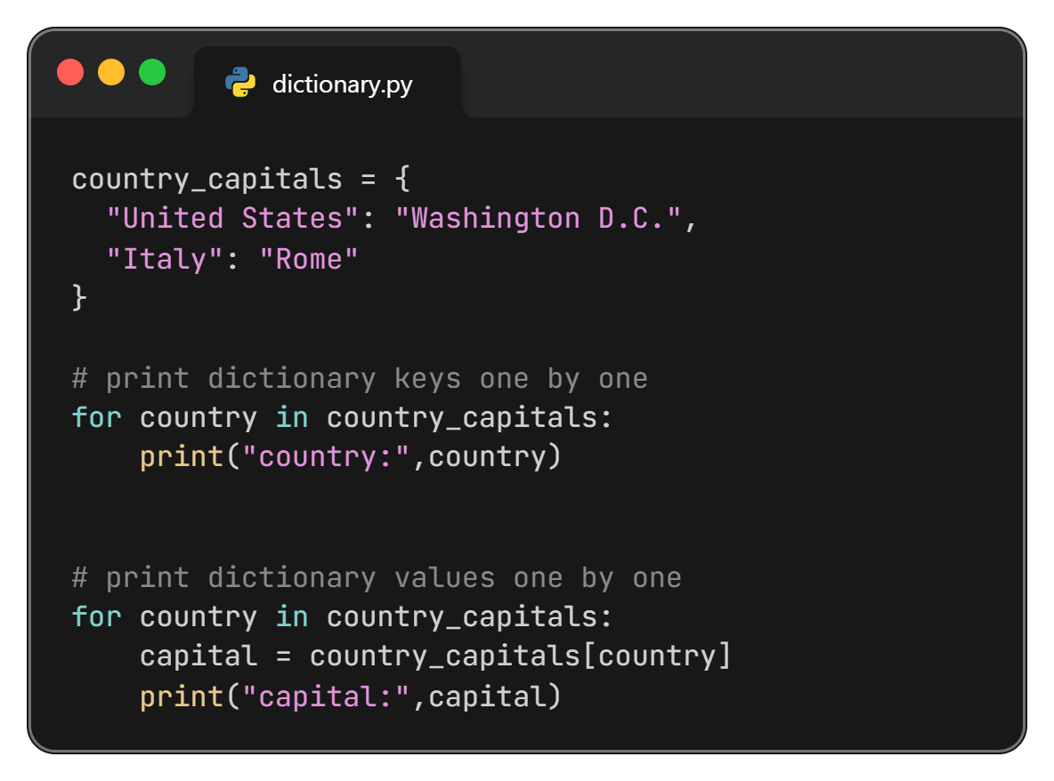
Iterate Through a Dictionary

Slide 21
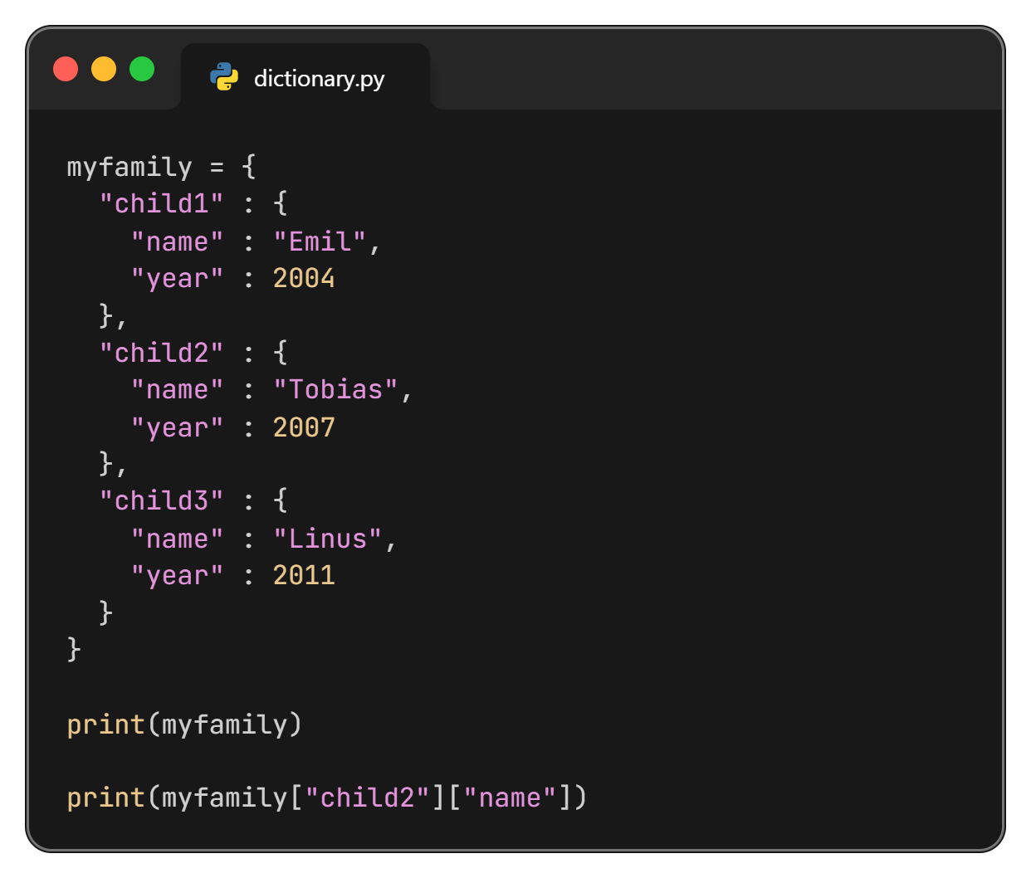
Nested Dictionary

Slide 22
Thanks All

